Slide 1





ARE YOU READY ?

Slide 2









Slide 3
How Many Times Have
You Forgotten Your Passwords?

Slide 4




Fakrny
Never Lose
Your Data Again

Slide 5






_
Some Informations
Updates
Features
Users
Credits

Slide 6


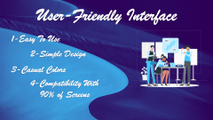

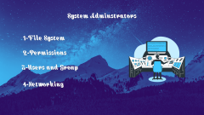







Features

Slide 7

Features

Slide 8
Features

Slide 9
Features

Slide 10
Features

Slide 11


User-Friendly Interface
1-Easy To Use
2-Simple Design
3-Casual Colors
4-Compatibility With
90% of Screens

Slide 12


Functionality
1-High Speed & Performance
2-Low Memory Usage
3-Customizble
4-Stability

Slide 13


Compatibility

Slide 14


Security

Slide 15


Pricing and Value

Slide 16
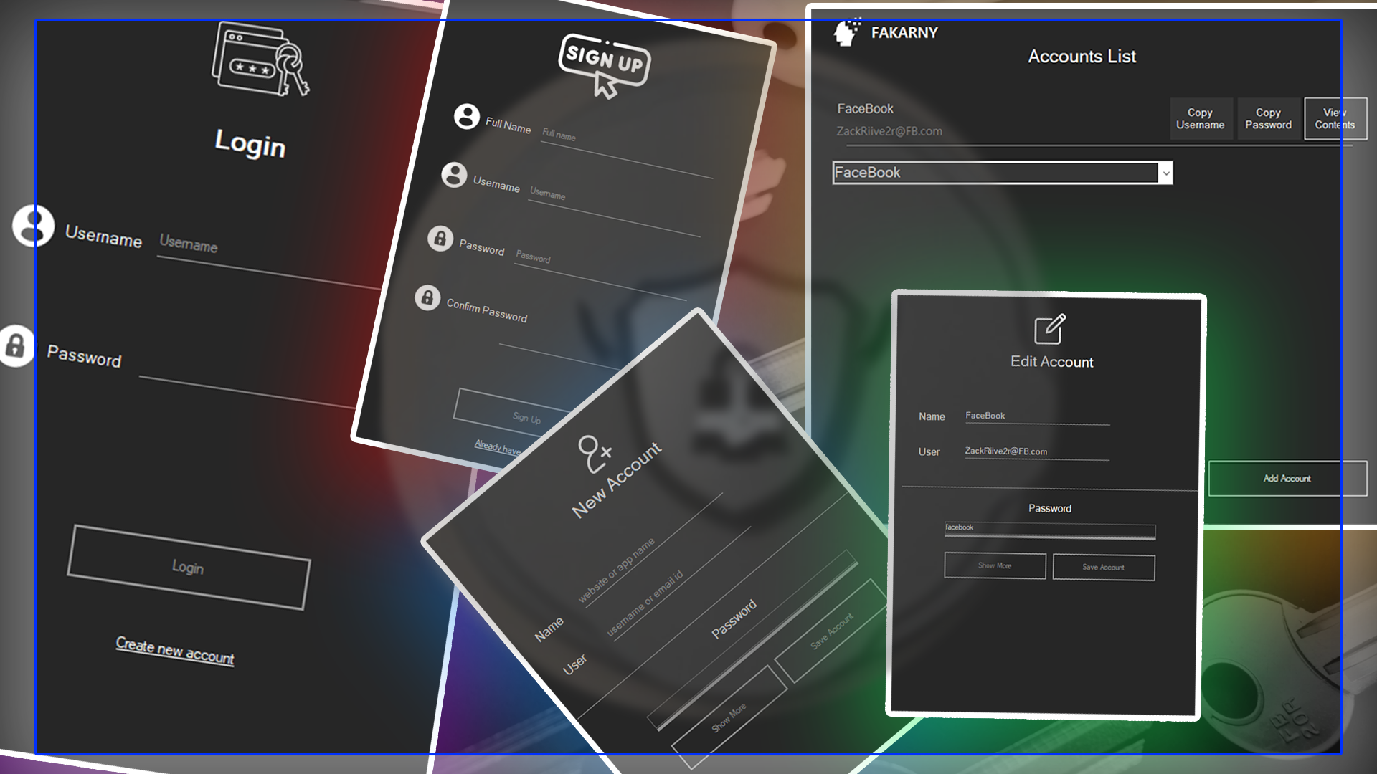




Slide 17



CONCLUSION

Slide 18

Designed By:
Abdallah Wageeh
ZACK RIVER
SEC 1

Slide 19

Made By (Rivers):
Abdallah Wageeh (Sec 1)
Tarek Ashraf (Sec 1)
Abdulrahman Ehab (Sec 1)
Anas Mahmoud (Sec 1)
Mennna Khaled (Sec 2)

